Slide 1

Speed Dating
Anna Li
Notes:
As technology develops, people are less and less likely to meet potential partners through organic means. Dating is approaching a new era where online dating applications are quickly rising in popularity. This project utilizes data from a speed dating experiment to examine trends in what people value when looking for partners through brief interactions.

Slide 2
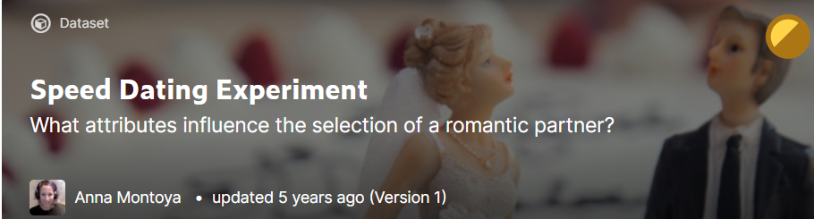
Data – Kaggle
Columbia Business School Professors Ray Fisman and Sheena Iyengar
Speed dating event – 4 minutes each
Attributes: Attractiveness, Sincerity, Intelligence, Fun, Ambition, Shared Interests
Demographic Info and other questions

Slide 3
Purpose and Target Audience
Examine trends in what people value when looking for partners through brief interactions to increase the number of successful matches.
Online dating services (Tinder, Bumble, Hinge) – algorithms
Dating agencies
Matchmakers

Slide 4
Data Cleaning
8378 rows and 195 columns
Filtering through columns
Null values → mean or median
Inconsistent point system for attributes

Slide 5
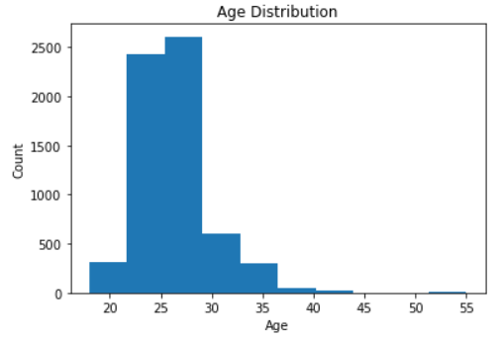
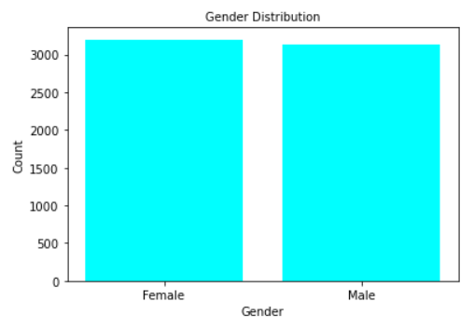
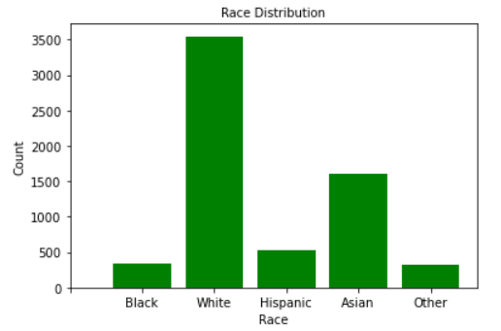
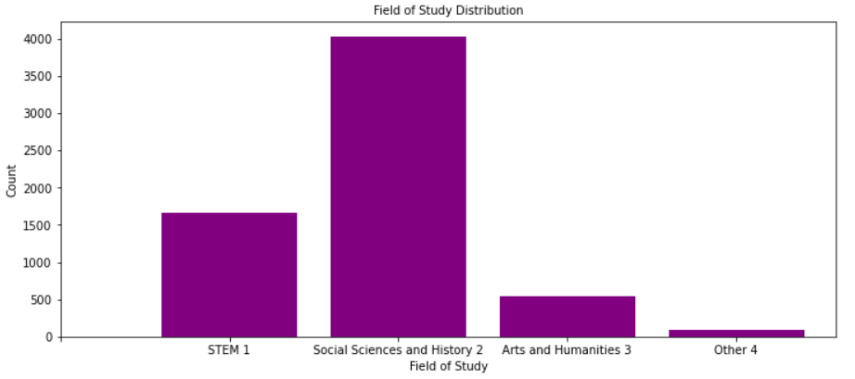
Exploratory Data Analysis
Notes:
Most in their 20s, good rep of general dating pool today
About the same number of males and females participated
Most were white, followed by Asian
Most were in social sciences and history, includes business, followed by stem

Slide 6
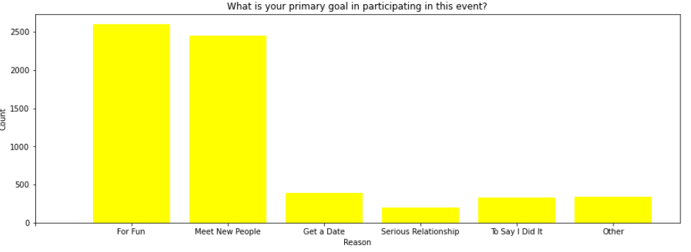
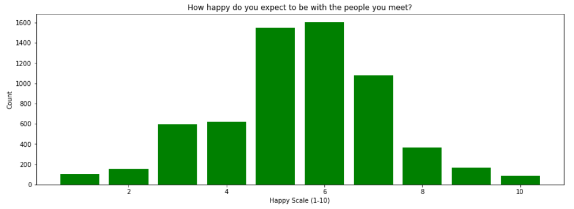
Notes:
Most people not expecting to get anything meaningful out of the dating event, super casual
Again pretty low expectations, most around 5 or 6
Shows one of the major problems with the type of dating with a large number of brief interactions, people just don’t have high hopes or are even looking for something seriously

Slide 7
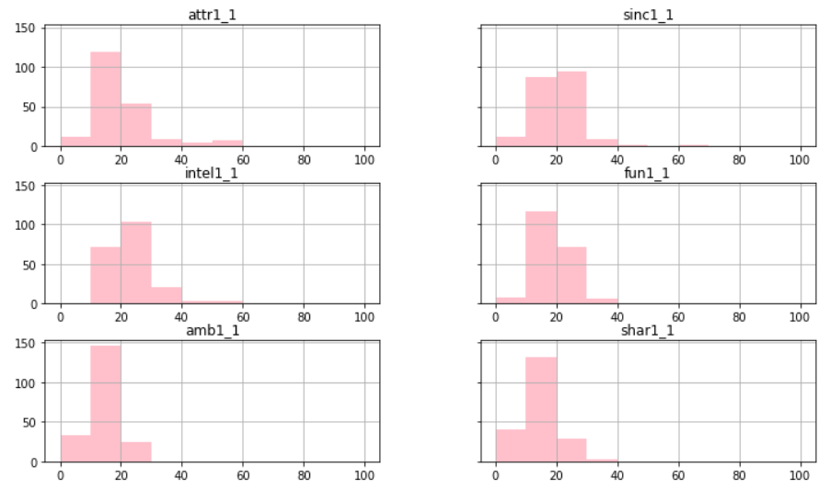
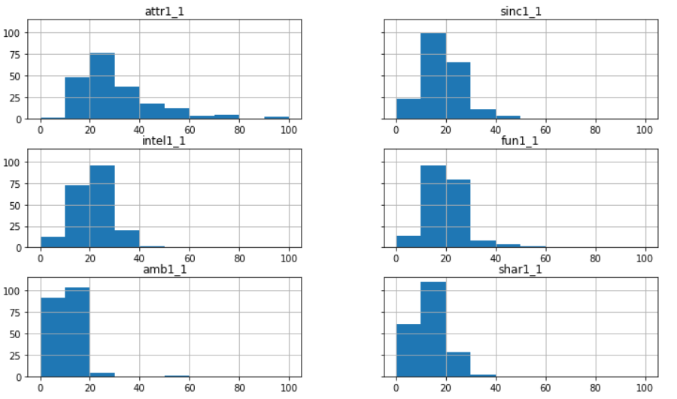
What do you look for in the opposite sex?
Notes:
100 point allocation system, if equally allocated about 17 points per section
Pay attention to values above 20, below 10
Men value attractiveness much more than women
Both men and women value sincerity, intelligence, and fun
A lot of men do not care about a woman being ambitious
Shared interests average to low importance

Slide 8
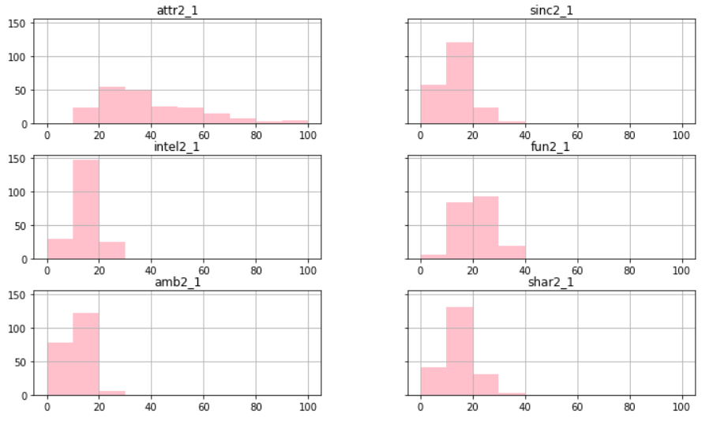
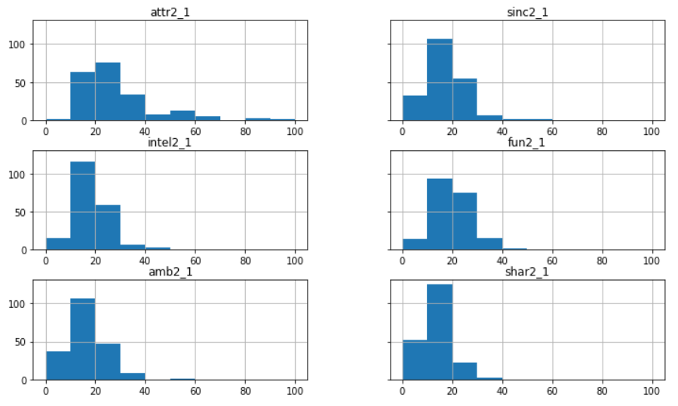
What do you think the opposite sex looks for in a date?
Notes:
-both genders think the opposite gender really cares about looks, women feel this way stronger than men
-women think that men care less about sincerity, men think that women care more about sincerity
-men think women care more about intelligence
-both think the other gender values fun
-women don’t think men care if they are ambitious
-shared interests is of low to average importance

Slide 9
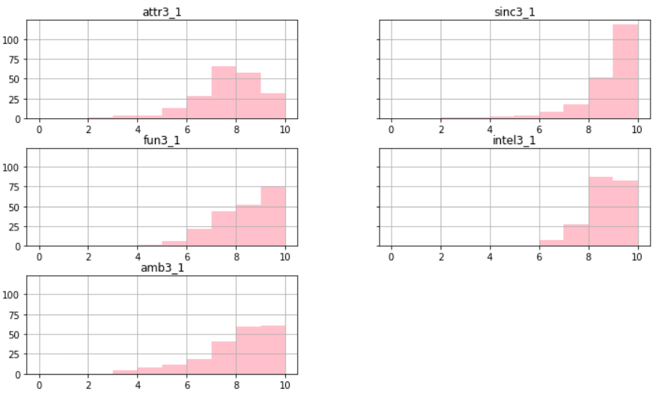
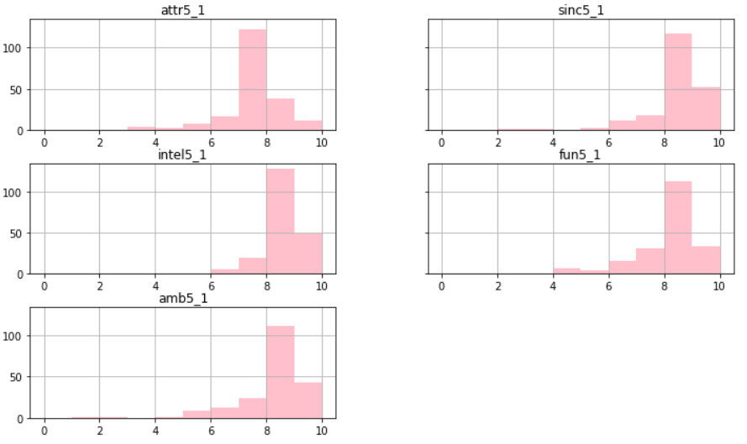

How do you think you measure up
How do you think others perceive you
Notes:
Others perceive less than what they think of themselves: attractive, sincerity
Others perceive more than what they think of themselves: fun, ambitious
Looks like women are generally pretty confident in their own attributes

Slide 10
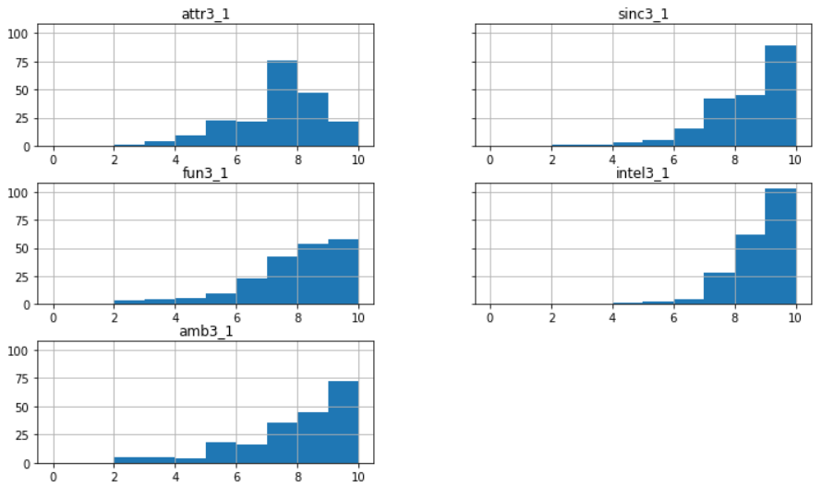
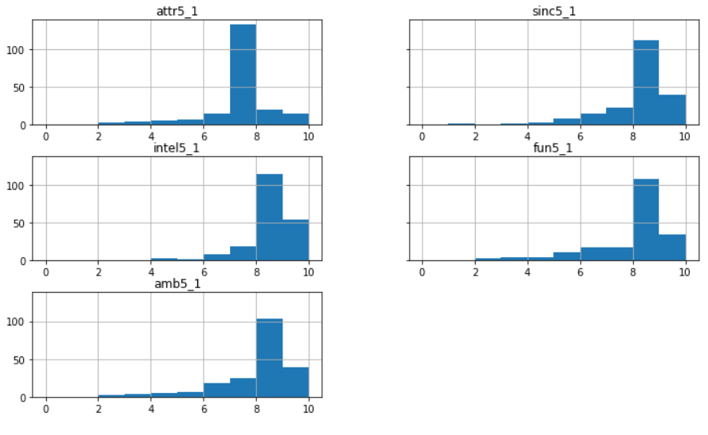
How do you think you measure up
How do you think others perceive you
Notes:
Same trends as women except men view themselves as very intelligent and more ambitious
- again very confidence in themselves for the most part

Slide 11
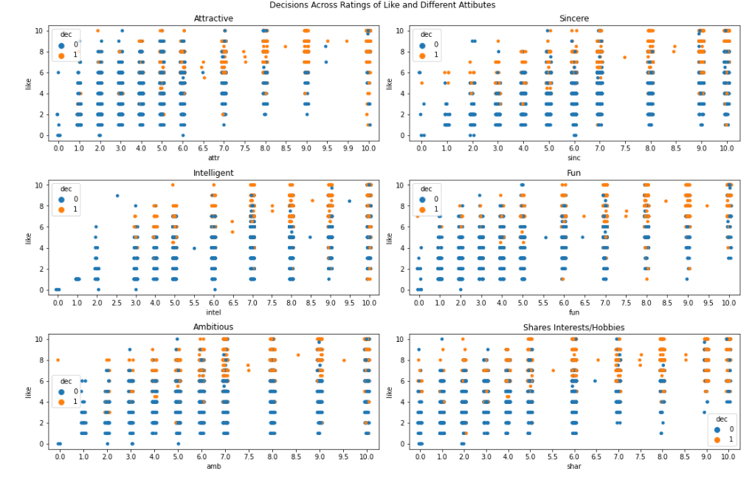
Notes:
-how much the participant likes their date is generally positively correlated with their decision as yes
Except for attractive and intelligent, many cases where date is high in those attributes and the participant didn’t like them at all and still said yes
So many cases where participants really liked their date and still said no when they thought they had low attractiveness
Intelligence, ambition, sincerity, shared interests help but not as important
Fun is important

Slide 12
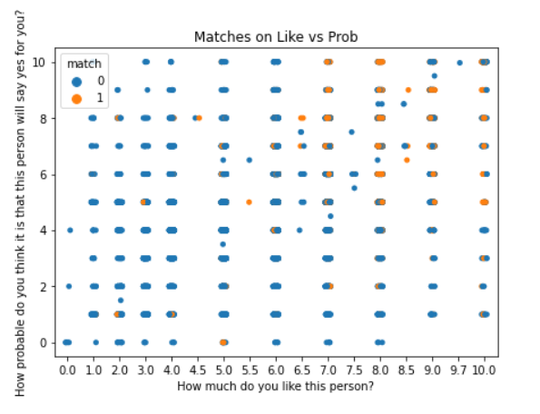
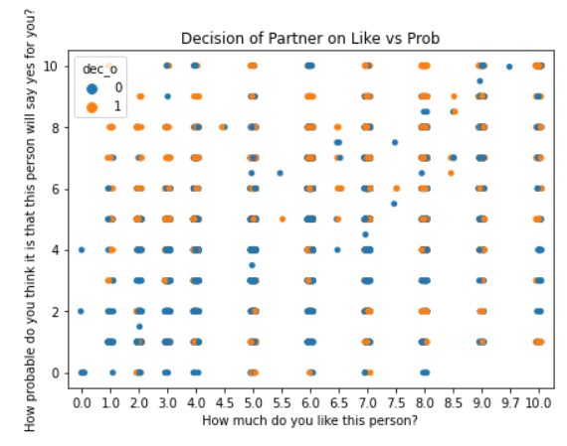
Notes:
(L) Generally it’s more likely to be a match when participants really like the other person and think the person will say yes for them.
(R) there are so many cases where participants don’t think the other person will say yes, but they do and they match!
Implies people actually aren’t that confident in themselves or cannot express themselves clearly

Slide 13
Preprocessing and Training
Categorical data: one-hot encoding
Upsampling for class imbalance
Defined variables
Train-test split: 80/20 + Standardization
Feature selection: SelectKBest
Dec, attr, fun, shar, like, prob, match_es

Slide 14
Logistic regression
 | Precision | Recall
0 | 0.99 | 0.68
1 | 0.77 | 0.99
Model
Accuracy score: 84.7% on train, 84.2% on test
Hyperparameter Tuning (GridSearchCV)
C: 0.1, penalty: l2
Accuracy score: 84.8% on train, 84.2% on test
 | Precision | Recall
0 | 0.98 | 0.68
1 | 0.77 | 0.99

Slide 15
Decision Tree
 | Precision | Recall
0 | 0.96 | 0.70
1 | 0.78 | 0.97
Gini Index
Accuracy score: 84.9% on train, 84.0% on test
Entropy
Accuracy score: 84.8% on train, 84.6% on test
 | Precision | Recall
0 | 1.00 | 0.68
1 | 0.77 | 1.00

Slide 16
Random Forest
Hyperparameter Tuning - RandomizedSearchCV
n_estimators: 50
Min_samples_split: 2
Min_samples_leaf: 1
Max_features: auto
Max_depth: None
Bootstrap: false
Accuracy score: 98.0% on train, 92.1% on test
 | Precision | Recall
0 | 0.97 | 0.86
1 | 0.88 | 0.98

Slide 17
Support Vector Machine
 | Precision | Recall
0 | 1.00 | 0.68
1 | 0.77 | 1.00
Model
Accuracy score: 84.7% on train, 84.6% on test
Hyperparameter Tuning – GridSearchCV
C:10, gamma:1, kernel:rbf
Accuracy score: 84.7% on train, 94.3% on test
 | Precision | Recall
0 | 0.97 | 0.91
1 | 0.92 | 0.97

Slide 18
What do we value in our model?
Focus on 1 (Match) rather than 0 (No Match)
True Positive: actual value 1, predicted value 1
False Negative: actual value 1, predicted value 0
True Negative: actual value 0, predicted value 0
False Positive: actual value 0, predicted value 1
Is cost of false negative or false positive higher?

Slide 19
Findings and Conclusion
General Trends
Attractiveness and Intelligence are the most important
People come off confident but during dating they have a hard time reading other people and expressing themselves
Not as confident as they appear
Perhaps because of time
Superficial
Best Model
Entropy Decision Tree
Support Vector Machine
Run time?

Slide 20
Future Steps
Tableau dashboard
Project on mobile dating application

Slide 21
Questions?

